Slide 1

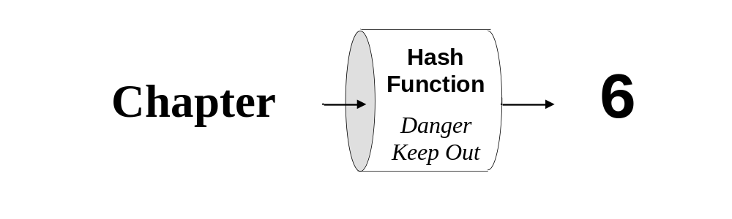
Java
Methods AB
TM
Maria Litvin
Gary Litvin
Data Structures
Set Interface
Copyright © 2003-2004 by Maria Litvin, Gary Litvin, and Skylight Publishing. All rights reserved.

Slide 2
Objectives:
Review the Set interface and implementations!
Learn how to use the TreeSet and HashSet classes
Notes:
HashSet is a different implementation of the Set interface. It uses a hash table instead of the binary search tree used in TreeSet.

Slide 3
Sets
A set represents a collection in which an object may occur only once
The java.util.Set<E> interface represents a set
java.util.TreeSet<E> implements a set as a BST
TreeSet<E> assumes that it holds comparable objects (or a comparator is passed to the TreeSet constructor)
Notes:
The main differences between a Set and a List is that a set cannot contain equal objects and that set elements are not arranged by index.

Slide 4
Java Collections Framework
«interface»
Collection
«interface»
List
«interface»
Set
ArrayList
LinkedList
TreeSet
HashSet
(Ch 6)

Slide 5
Some of the Set<E>
(and TreeSet<E>) Methods
  int size( );
  boolean isEmpty ( );
  boolean add (E obj);
  boolean remove (Object obj);
  boolean contains (Object obj);
  Iterator<E> iterator ( );
  E [ ] toArray ( );
Returns false if obj is already in the set
Returns true if obj was in the set
Notes:
Since Set and List both extend Collection, many of their methods are the same (isEmpty, add, remove, contains, etc. But add(obj, index) is specific to List.

Slide 6
TreeSet<E> //E is Comparable
Is implemented as a BST
compareTo (or comparator’s compare) is used by the add, contains, and remove methods
An iterator returned by the iterator method implements inorder traversal
Inorder traversal of any BST retrieves values in ascending order
Notes:
TreeSet keeps values in a “balanced” tree; the time needed to locate a value is proportional to the depth of the tree, most of the time log(n) where n is the size of the set.

Slide 7
Lookup Tables
The value of a key is directly translated into an array subscript using a simple formula
The array stores the values associated with keys
The mapping from all the keys into integer subscripts must be unambiguous
The subscript that corresponds to a key must fall into the valid range (from 0 to array.length - 1)
Notes:
A lookup table may waste space, but it provides instantaneous access to the data — no search is needed.

Slide 8
Applications of Lookup Tables
Data retrieval
Data compression and encryption
Tabulating functions
Color mapping

Slide 9
Hash Tables
The value of a key is translated into an array subscript using a hash function
The subscript that corresponds to a key must fall into the valid range
The hash function can map different keys onto the same element in the array — this situation is called collision
Notes:
Hash tables build upon the lookup table idea, only in a hash table several values can fall into the same location.

Slide 10
Hash Tables (cont’d)
The hash function should map the keys onto the array subscripts randomly and uniformly
A well-designed hash table and hash function minimize the number of collisions
There are two common techniques for resolving collisions: chaining and probing
Notes:
Chaining is more common. The Java library uses chaining.

Slide 11
java.util.HashSet<E> Class
Implement the Set interface, using hash tables (with chaining)
May be more efficient for searching than TreeSet
Notes:
But HashSet and HashMap may waste some space.

Slide 12
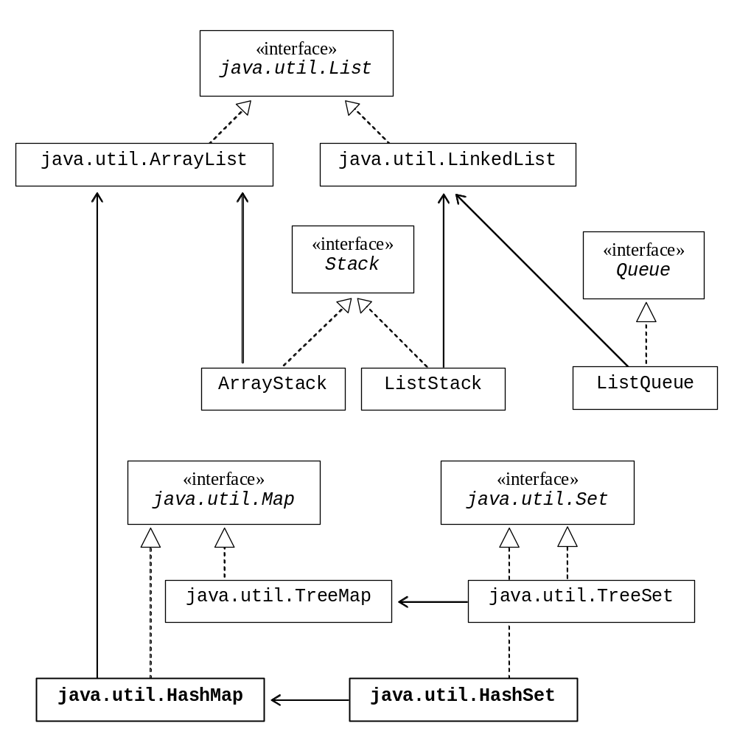
The Big Picture
Notes:
Actually HashMap does not use ArrayList: it uses a built-in array and keeps track of the table size and capacity itself. HashSet is implemented as a special case of a HashMap.

Slide 13
HashSet (cont’d)
Collisions are resolved through chaining
The sizes of buckets must remain relatively small
Load factor:
Total number of values
Number of buckets
= Load factor
Notes:
0.75 is considered a reasonable load factor, which means the number of values does not exceed 3/4 of the number of buckets.

Slide 14
HashSet (cont’d)
Fine tuning:
  Load factor too large → lots of collisions
  Load factor too small → wasted space and slow iterations over the whole set
If the load factor exceeds the specified limit, the table is automatically rehashed into a larger table; if possible this should be avoided

Slide 15
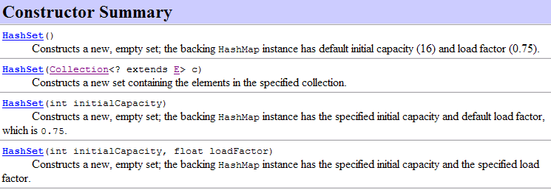
The HashSet Class
Notes:
Only the no-args constructor is needed for the AP exams.

Slide 16
Some of the Set<E>
(and HashSet<E>) Methods
The total number of values (NOT buckets)
  int size( );
  boolean isEmpty( );
  boolean add(E obj);
  boolean remove(Object obj);
  boolean contains(Object obj);
  Iterator<E> iterator( );
  E[ ] toArray( );
Returns false if obj is already in the set
An iterator returns the values in the set in unspecified order
Notes:
The same methods as in TreeSet. An iterator returns the values in no particular order.

Slide 17
TreeSet<E> // E is Comparable
Is implemented as a BST
compareTo (or comparator’s compare) is used by the add, contains, and remove methods
An iterator returned by the iterator method implements inorder traversal
Inorder traversal of any BST retrieves values in ascending order
Notes:
TreeSet keeps values in a “balanced” tree; the time needed to locate a value is proportional to the depth of the tree, most of the time log(n) where n is the size of the set.

Slide 18
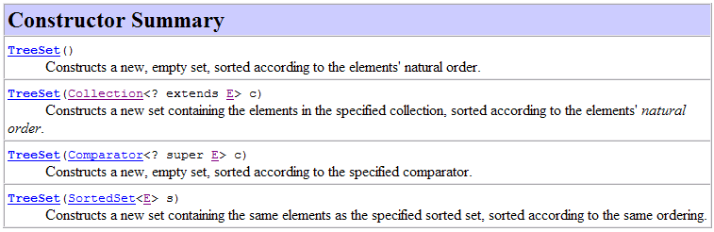
TreeSet (cont’d)
Never mind...
Notes:
Only the no-args constructor is needed for the AP exams.

Slide 19
Iterating over a Set<E>
Set<E> mySet = /*some set of E*/
for(E e : mySet)
SOPln(e);
Iterator<E> it = mySet.iterator();
While (it.hasNext())
E temp = it.next();
Notes:
TreeSet keeps values in a “balanced” tree; the time needed to locate a value is proportional to the depth of the tree, most of the time log(n) where n is the size of the set.

Slide 20
HashSet (cont’d)
Objects in a HashSet must have a reasonable int hashCode ( ) method that redefines Object’s hashCode and helps to calculate the hashing function
The hashCode method returns an int from the entire int range; it is later mapped on the range of subscripts in a particular hash table
String, Integer, Double each have a reasonable hashCode defined
Notes:
The transformation of the value returned by hashCode() into the actual bucket index may involve some additional hashing. Then the index must be mapped onto the range of the indices in the table: from 0 to size - 1. This involves truncation. The Java library uses tables of the size equal to a power of two and doubles the size of the table if it needs to expand the table.

Slide 21
Consistency
HashSet first use hashCode, then equals
TreeSet use only compareTo (or a comparator)
For consistent performance, these methods should agree with each other:
  x.equals(y) ⇔ x.compareTo(y) == 0
  x.equals(y) ⇒ x.hashCode( ) == y.hashCode( )
Notes:
Thus, it is a good idea for Comparable objects to also redefine the equals and hashCode methods.

Slide 22
Review:
What is the main difference between a lookup table and a hash table?
How is hash table performance affected when the load factor is too high? Too low?
What happens to a HashSet when the load factor exceeds the specified limit?
HashSet’s no-args constructor sets the initial capacity to 16 and the load factor limit to 0.75. How many values can be stored in this table before it is rehashed?
Notes:
What is the main difference between a lookup table and a hash table?
In a lookup table, only one value can be placed into each slot; in a hash table several values may be placed into the same slot.
What is a collision?
A situation where two different values are mapped onto the same entry in the table.
Name two common techniques for resolving collisions.
Chaining and probing.
What is a bucket?
A collection that holds all the values that fall into the same hash table entry.
What is a load factor?
The ratio of the number of values stored in the hash table to the table size.

Slide 23
Review (cont’d):
What is the sequence of values returned by an iterator for a HashSet?
What is the range of values for the hashCode method?
Which method(s) of an object are used to find it in a TreeSet? A HashSet?
Notes:
What is the sequence of values returned by an iterator for a HashSet?
No particular sequence, random.
What is the range of values for the hashCode method?
All integers.
Which method(s) of an object are used to find it in a TreeSet? A HashSet?
TreeSet — compareTo; HashSet — first hashCode, then equals.

Slide 24
Homework
Read Chapter 6 in the book
01. Set Worksheet.doc

Slide 25
Programs
Look on the K drive for more information about
  AllenWittrySet
  The Morse Code lab
  Dora’s Great Map Adventure

